Slide 1


Data Types
Soham

Slide 2
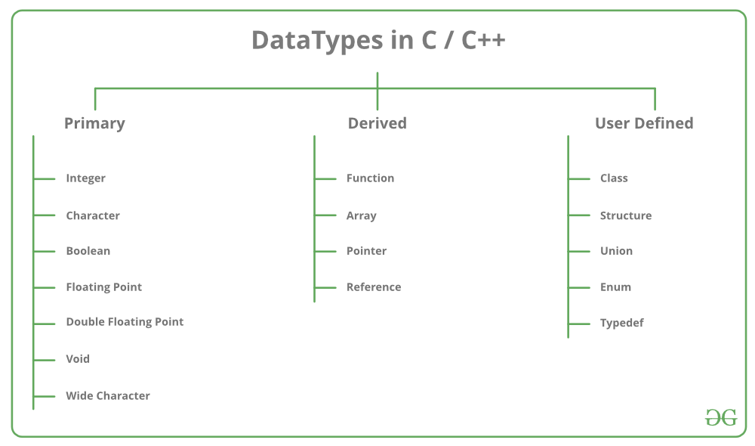

Slide 3

Primary or Primitive Data Type
Integer
Character
Boolean
Floating Point
Double Floating Point
Valueless or Void
Wide Character

Slide 4
Primitive data types available in C++.
Integer:
Keyword : int.
Size: 4 bytes
Range: -2147483648 to 2147483647.
Character:
Keyword: char.
Size : 1 byte
Range: -128 to 127 or 0 to 255.
Boolean:
Keyword : bool
Size: 1 byte
Range: true or false. (Only 2 values)
Floating Point:
Keyword : float.
Size: 4 byte.
Range: 3.4E +/- 38 (7 digits)
Double Floating Point:
Keyword: double.
Size : 8 byte.
Range: 1.7E +/- 308 (15 digits)
Wild Character:
Range: wchar_t
Size: 2 byte.
Range: 0 to 65,535
void: Void means without any value. void datatype represents a valueless entity. Void data type is used for those function which does not returns a value.

Slide 5
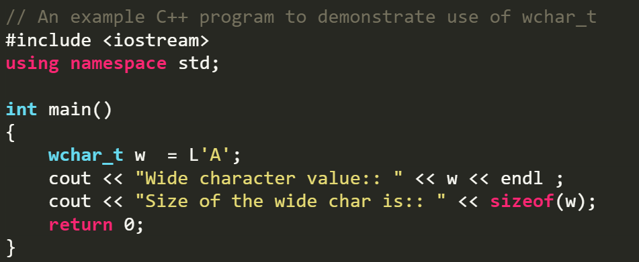
Wide char
Wide char is similar to char data type, except that wide char take up twice the space and can take on much larger values as a result. char can take 256 values which corresponds to entries in the ASCII table.
On the other hand, wide char can take on 65536 values which corresponds to UNICODE values which is a recent international standard which allows for the encoding of characters for virtually all languages and commonly used symbols.
For more info : Read Here

Slide 6
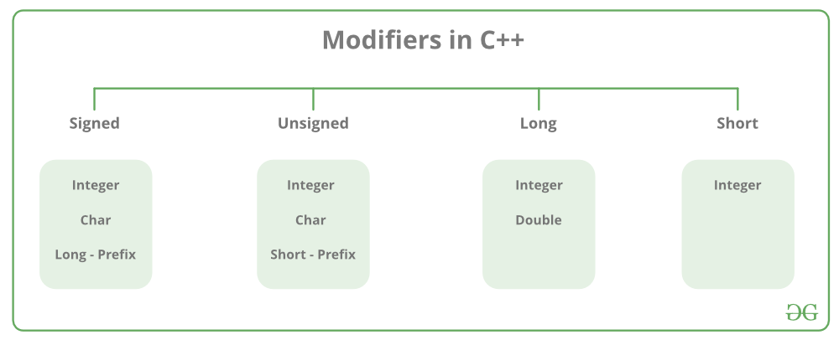

Slide 7
Type Name | Bytes | Range of Values
char or signed char | 1 | -128 to 127 (-(2^7) to (2^7) -1 )
unsigned char | 1 | 0 to 255 (0 to (2^8) -1 )
bool | 1 | false or true
short int or signed short int | 2 | -32,768 to 32,767 (-(2^15) to (2^15) -1 )
unsigned short int | 2 | 0 to 65,535 (0 to (2^16) -1 )
int | 4 | -2,147,483,648 to 2,147,483,647 (-(2^31) to (2^31) -1 )
unsigned int | 4 | 0 to 4,294,967,295 (0 to (2^32) -1 )
long long int | 8 | -9,223,372,036,854,775,808 to 9,223,372,036,854,775,807 (-(2^63) to (2^63) -1 )
unsigned long long int | 8 | 0 to 18,446,744,073,709,551,615 (0 to (2^64)-1)
float | 4 | 3.4E +/- 38 (7 digits)
double | 8 | 1.7E +/- 308 (15 digits)
long double | 8 | Same as double
enum | varies
wchar_t | 2 | 0 to 65,535

Slide 8
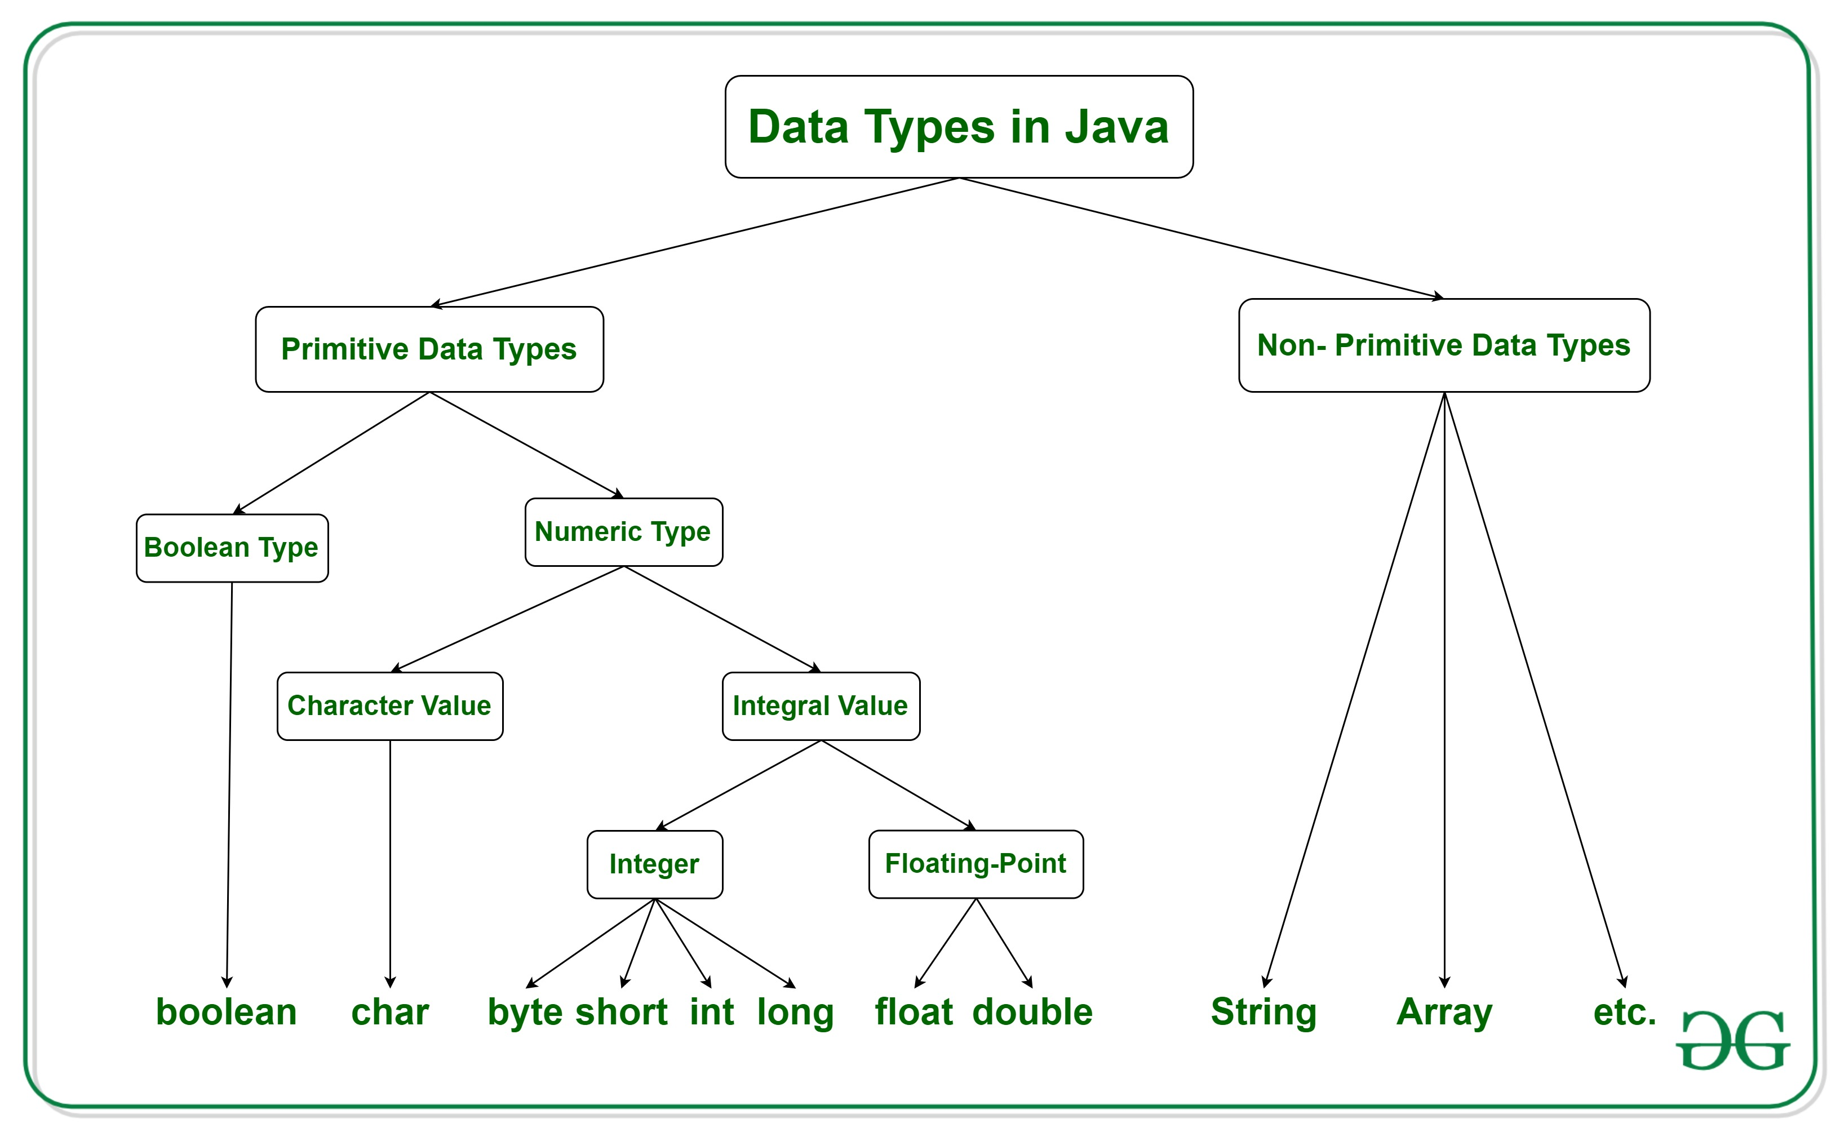

Slide 9
Primitive data types available in JAVA
Integer:
Keyword : int.
Size: 4 bytes
Range: (-(2^31) to (2^31) -1)
Floating Point:
Keyword : float.
Size: 4 bytes.
Range: 3.4E +/- 38 (7 decimals)
Double Floating Point:
Keyword: double.
Size : 8 bytes.
Range: 1.7E +/- 308 (16 decimals)
Character:
Boolean:
Keyword: boolean
Size: 1 byte
Range: true or false. (Only 2 values)
Byte:
Keyword: byte
Size: 1 byte
Range: true or false. (Only 2 values)
Keyword: short
Size: 2 bytes
Range: -(-(2^15) to (2^15) -1)
Long:
Keyword: long
Size: 8 bytes.
Range: (-(2^63) to (2^63) -1)
Short:
Keyword: char.
Size: 1 byte
Range: -128 to 127 or 0 to 255.

Slide 10
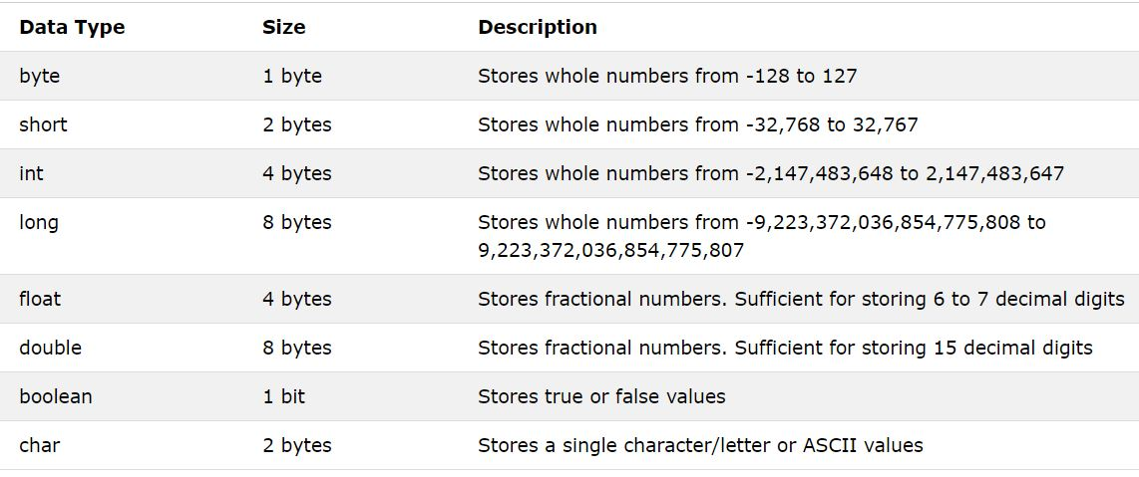

Slide 11
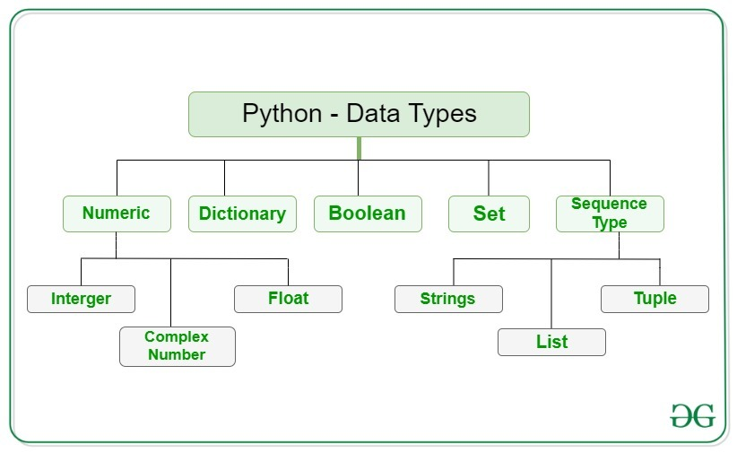

Slide 12
All Data Types in Python
Text Type: str
Numeric Types: int, float, complex
Sequence Types: list, tuple, range
Mapping Type: dict
Set Types: set, frozenset
Boolean Type: bool
Binary Types: bytes, bytearray, memoryview
IMPORTANT:
There are no range limitations in Python.
(except float (Upto 17 digits))

Slide 13
Type | Size (in Bytes) | Notes
int | 24 (for 0) | 28 – System Memory
float | 24 | Range: upto 17 digits
complex | 32
str | 49 (Empty String) | +1 per additional character (49+total length of characters)
tuple | 40 (Empty Tuple) | +8 per additional item in tuple ( 40 + 8*total length of characters )
list | 56 (Empty List) | +8 per additional item in list ( 56 + 8*total length of characters )
set | 216 | 0-4 take size of 216. 5-19 take size 728. 20th will take 2264 and so on…
dict | 232 | 0-5 takes size of 232. 6-10 size will be 360. 11th will take 640 and so on…

